Slide 1
Argiro Library App

Slide 2
Agenda
Team presentation
Demo App
Class diagram presentation
Diagrams
User case 1
Sequence diagram 1
User case 2
Sequence diagram 2
User case 3
Sequence diagram 3
User case 4
Sequence diagram 4
User case 5
Sequence diagram 5
User case 6
Sequence diagram 6

Slide 3
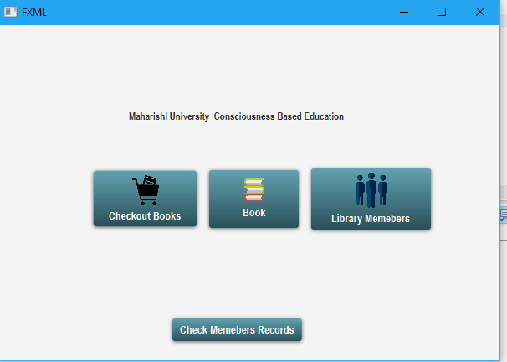
Argiro Library App

Slide 4
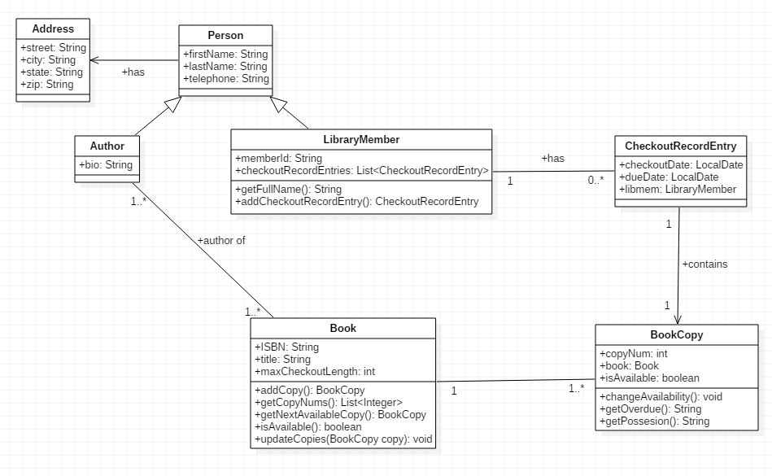
Class diagram

Slide 5
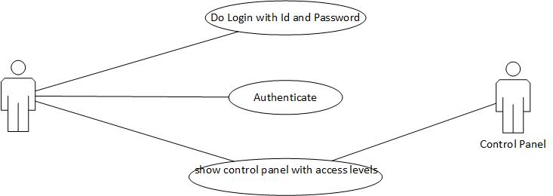
User case 1

Slide 6
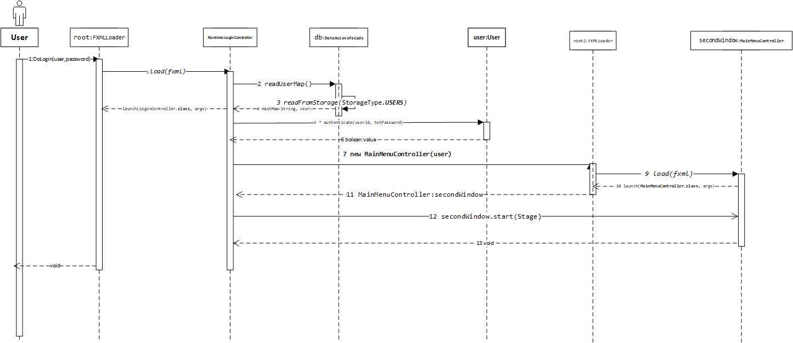
Sequence diagram 1

Slide 7
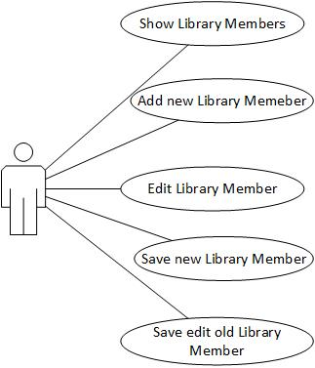
User case 2

Slide 8
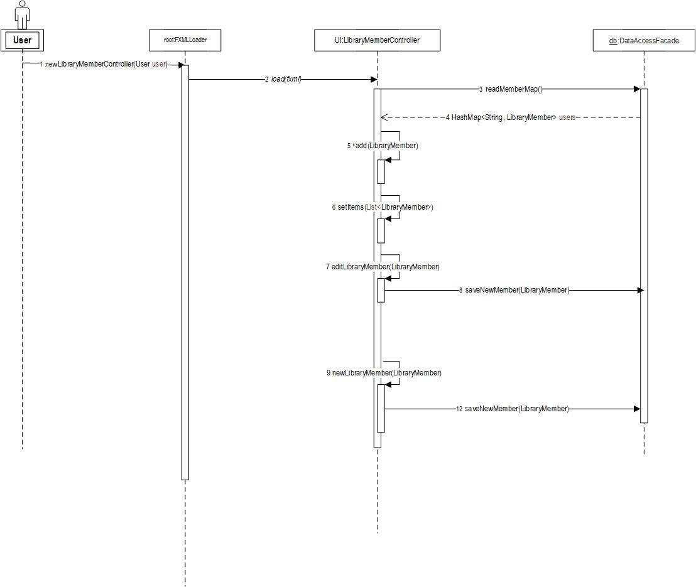
Sequence diagram 2

